Slide 2
MODULE 3
Including all students in mathematics learning experiences
This could be the
range of students
in your class…
and you have
to teach all
of them…
Notes:
The graphic includes a distribution of NAPLAN scores for the respective year levels, intending to represent graphically the challenge of dealing with difference.
The graph illustrates that there are quite a few year 9 students who scored below the median of year 5 students, and quite a few year 5 students who are above the mean of year 9 students. Of course the scaling makes such graphs difficult to use to make firm judgments, but they do illustrate the significance of differences in achievement across the student cohorts.
It is noted that the goal, in the reSolve project at least, is to offer all students experiences that are appropriately challenging using content from the curriculum at the year they are operating. You might invite participants to comment on what the graphic “says” to them.

Slide 3
Module 3 overview
The elements of the reSolve project
Considering the nature of difference
Some strategies you can use
Building learning on a common experience
Low floor, high ceiling tasks
Enabling and extending prompts
Applying the strategies to other tasks
Using these approaches in planning and teaching
Notes:
This is an overview of the module
Part 1 is an overview of the reSolve project. If participants have done module 1 or any of the Professional Learning modules, slides 4 to 12 can be skipped.
The module is designed to run for two hours. The suggested timings of the parts are in the Background Notes.

Slide 4
Part 1: The reSolve Project
Click here if you have already done a PD Module
Notes:
This part is to contextualise what is to follow.
If participants have done module 1 or any of the Professional Learning modules, slides 4 to 12 can be skipped.

Slide 5
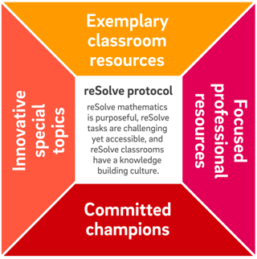
Overview of the reSolve: Mathematics by Inquiry Project
Notes:
The graphic illustrates 5 aspects of the reSolve project. Each of these aspects is elaborated in the following slides.

Slide 6
Classroom Resources
Exemplary classroom resources at every level from Foundation to Year 10 that embody a spirit of inquiry and enact the reSolve Protocol.

Slide 7




Classroom Resources
Notes:
This icons are illustrative of the resources that are available on the website.

Slide 8
Special Topics
Addressing identified needs or exploring new boundaries.
Special Topics are significant resources that address the needs of 21st century learners. They:
are substantial units of work and accompanying resources that address major current gaps;
prioritise the Australian Curriculum proficiencies of reasoning and problem solving;
provide imaginative opportunities for creatively using new technologies and real world contexts; and
respond to the results of international assessments that show that solving real problems is a specific area of weakness for Australian students.
Notes:
There is no need to spend time on this. Participants who want more details can be directed to the website.

Slide 9
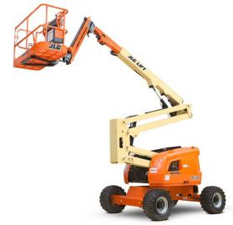
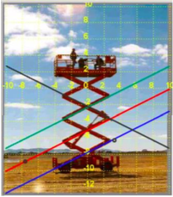
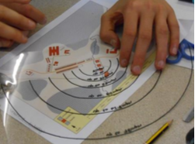
Special Topics
Mechanical Linkages and Deductive Geometry | Bring Algebra into the Real World | Modelling Motion | Bar Model Method
Assessing Reasoning | Mathematics and Algorithmic Thinking | Mathematical Modelling | Mathematical Inquiry into Authentic Problems

Slide 10
Professional Learning Modules
Resources to support in-school leaders to address key issues and themes in the teaching and learning of mathematics through collegial professional learning programs.

Slide 11
Professional Learning Modules
PLM 1: reSolve: Mathematics by Inquiry Introducing the reSolve Protocol and some of the resources | PLM 2: Mathematical purpose and potential | PLM 3: Including all students in mathematics learning experiences | PLM 4: The role of challenging mathematical experiences in activating thinking of all students.
PLM 5: Using student strategies and solutions as part of inquiry learning in mathematics | PLM 6: Adapting existing inquiry resources and creating your own | PLM 7: Activating mathematical thinking then consolidating learning | PLM 8: Leading the incorporation of inquiry approaches into mathematics teaching repertoires: A workshop for current and potential leaders
Notes:
This is the list of the titles of the various modules. The intention is that the modules can be accessed individually or in sequence.
PLM 6 and 7 will be trialled in 2018.

Slide 12
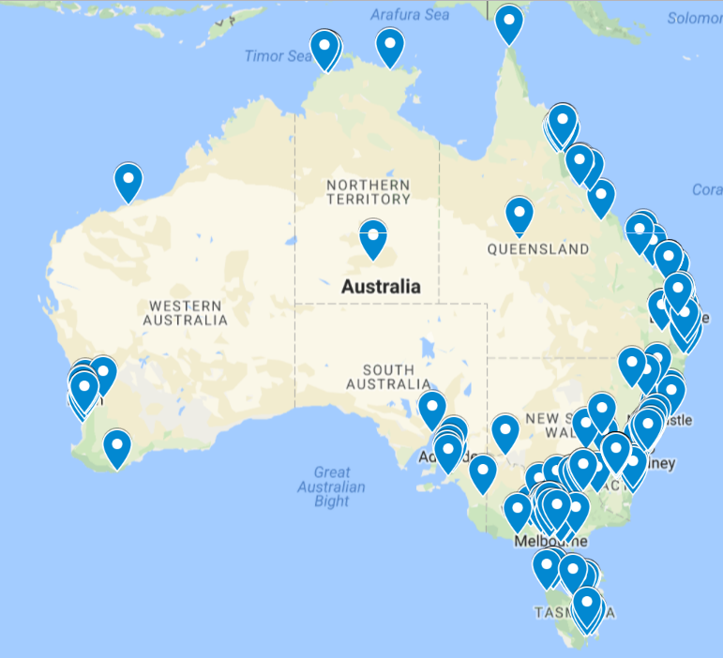
reSolve Champions
A community of more than 290 committed leaders across the country, who will use reSolve resources and approaches in professional learning programs they lead during and after the development phase of reSolve (finishes mid-2018).

Slide 13
The reSolve Protocol is the driver for all that the project is about, and does.
In order to foster a spirit of inquiry in all mathematics teaching and learning:
  reSolve mathematics is purposeful
  reSolve tasks are challenging yet accessible
  reSolve classrooms have a knowledge-building culture
Notes:
The Protocol has three parts which each address a different dimension of mathematics teaching.

Slide 14
In particular, this module addresses these statements from the Protocol
Providing opportunity for all students irrespective of background and experience.
Providing prompts and activities meeting a range of student capabilities, from those needing assistance to those ready for further challenge.
Notes:
The stem that precedes these statements from the Protocol is …
reSolve tasks are challenging yet accessible. reSolve contests a view that some students can “do” mathematics well and others cannot, by …:

Slide 15
This module addresses (in particular) the following AITSL Teaching Standards:
Standard 1 – Know students and how they learn
  1.5 Differentiate teaching to meet the specific learning needs of students across the full range of abilities
  1.6 Strategies to support full participation of students with disability
Standard 4 – Create and maintain supportive and safe learning environments
  4.1 Support student participation
Notes:
The AITSL teaching standards are written at four levels: Graduate; Proficient; Highly Accomplished; and Lead.
This module in particular addresses the above statements from Standards 1 and 4.
Of course, the module also contributes to addressing Standard 6 – Engage in professional learning

Slide 16
Part 2: The Nature of Difference
Notes:
This part allows participants to discuss the nature of difference and the challenge of including all students in the learning.
It is suggested that you show each slide and allow participants to read the slide. It is suggested that you print the handout which has the key statements for participants to read and make notes.
There is a plenary discussion at the end of this part. Give participants advance notice of this.

Slide 17
The nature of difference
ACARA says that in any class there is a 5 year gap.
Cockcroft (UK) reported a 7 year gap.
While we know that there are factors contributing to difference (experience, Indigenous, SES, geography, gender, race, ethnicity), even within these subgroups there is diversity.
Differences are not just in achievement, but aspirations, expectations, resilience, mindsets, confidence, and satisfaction.
Notes:
Invite participants to read through the slide (or the handout). Invite them to clarify any terms or ideas that may not be clear.

Slide 18
We are interested in …
Purposeful learning for everyone
- over the year all students should improve by at least 12 months
Not merely replicating student prior experience but extending it
- not “more of the same”
Efficient planning
- not preparing different lessons for different sub groups
Notes:
Three powerful statements supported with an explanatory clause.
Invite participants to read through the slide.

Slide 19
Some assumptions that underlie planning to include all students:
Warning: these assumptions may be confronting for some viewers.
Notes:
Acknowledge that we all have assumptions on which we base our teaching.
reSolve takes an explicit stance that all students have maximum opportunity to learn in mixed achievement whole class groups. Of course, the resources can also be used with other groupings.

Slide 20
Some assumptions that underlie planning to include all students:
All students can learn and have a right to the full range of curriculum experiences
- If I prevent students from having access to the full curriculum, I am perpetuating inequity and discrimination
Notes:
This is a reference from a presentation by Bill Barton at ICME 13. Equity means not “dumbing down” the expectations and tasks.

Slide 21
Some assumptions that underlie planning to include all students:
Students learn in different ways and at different rates and teaching needs to accommodate these differences
Our professional experience as teachers confirms this
Our professional expertise enables this in our classrooms
Notes:
Note that reSolve resources assume that teachers will accommodate differences within the one experience so that students feel they are part of a class community rather than feeling excluded from it.

Slide 22
Some assumptions that underlie planning to include all students:
The building of relationships, learning to communicate mathematically and learning from each other is easier when the whole class can discuss their experience together
- Quality education has always been a product of community

Slide 23
Some assumptions that underlie planning to include all students:
It is in whole class discussions that students can see alternate approaches and build connections between different ways of seeing concepts
- Our diversity is our strength. Our learning is enriched by finding multiple solutions and strategies

Slide 24
Some assumptions that underlie planning to include all students:
We want to minimise the effects of self-fulfilling prophecy by including all students in whole class teaching
- It is easier to destroy self-concept than it is to build it
Notes:
Note that the self-fulfilling prophecy effect is important for teachers to consider and indicates that there are implications for the ways we group students, the language we use with them and even our body language.

Slide 25

What do you see as the implications of such statements for planning, teaching and assessment?
Notes:
Invite participants to discuss what they see as the implications of such statements.
If there seems to be a consensus, record their comments. These can be used later in the module.

Slide 26
Part 3: Three Strategies for Planning to Address Difference
Strategy 1. Providing experiences to give all students access to the subsequent tasks (without reducing the challenge of those tasks).
Strategy 2. Posing tasks with “low floors” and “high ceilings” so that all students are working on the same task but in different ways.
Strategy 3. Preparing additional prompts that can support students experiencing difficulty and extend those who are ready.
Note that all three strategies can be applied separately or together.
Notes:
This part of the module offers some suggestions of strategies that can assist participants in planning to address difference in their classes.
The following slides illustrate the strategies using specific examples from reSolve tasks.
In the subsequent part of the module, participants discuss how the strategies might be applied to other tasks.

Slide 27
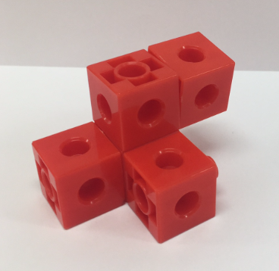


Examples of what the three strategies look like
Building Symmetry
Year 3
Handfuls
Foundation
Mathematical Mind Reading
Year 9
Chinese Bamboo
Year 10
Notes:
By clicking on the respective picture, the slideshow takes you to examples of the three differentiation strategies as they apply in that classroom resource.
It is assumed that if the participants are all primary teachers you would choose the Foundation and Year 3 examples.
It is assumed that if the participants are all secondary teachers you would choose the Year 9 and 10 examples.
If the group is mixed, it is suggested you choose just two of these to work through.

Slide 28
Part 4: Applying These Strategies to Other Tasks
Notes:
The next slide summarises the strategies.
After that, you can select one or more tasks from the project. The participants can then discuss in small groups how they might differentiate the experience drawing on the three strategies.
Note that this is not about these particular tasks but to illustrate a process that can be applied in all planning and teaching.

Slide 29
What were they again?
Providing initial experiences that give access for all students
Low floor, high ceiling
Prompts
      Enabling – review the representation, number of steps, size of numbers
      Extending – increase complexity and size of numbers, find multiple solutions, identify all possibilities, make a generalisation or rule
Notes:
This is to remind the participants of the suggested strategies.

Slide 30

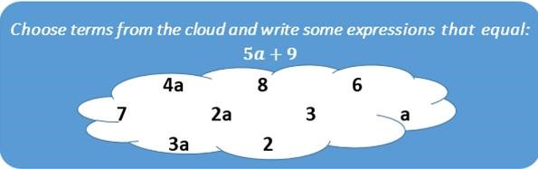

Choose a task to discuss.
Shadows
Year 1
Algebra Cloud
Year 7
= 2 points
Tossing Counters
Year 3
Jamos the Jeweller
Year 8
= 5 points
Notes:
By clicking on a photo or graphic you are taken to a task statement which then can be posed to participants for them to consider and discuss the different approaches to differentiation.
As before, it is assumed you will choose two of these that are appropriate to your audience.

Slide 31
Part 5: Applying These Approaches in Planning and Teaching
Notes:
Consider how these approaches might apply to planning and teaching generally.

Slide 32
Putting it into practice
These approaches are ways of thinking that can apply to all tasks and all interactions with students.
If we created guidelines for ourselves to encourage students to keep working on a task without taking away their opportunity to make their own meaning, what would those guidelines be?
Notes:
Participants are invited to suggest guidelines (for themselves) that can help them in responding to students experiencing difficulty and those ready for extension.
An example of a guideline might be “rather than telling, I will ask a question”. Another example might be “I will give students more time”.
If you made a list of participants’ comments at slide 25, you could show those again here.

Slide 33
What explicit language related to inclusion should we use …
What explicit language related to inclusion should we avoid …
… when communicating with students?
… when communicating with each other?
… when communicating with parents?
Notes:
The language that is used and avoided has a significant impact on the “flavour” of and commitment to inclusion in mathematics in the school.
The way that teachers communicate with each other is particularly significant.
Parents may need to be educated in the language of inclusion at the school.

Slide 34
How will our approach to making mathematics accessible for all students affect our planning …
… as we meet together?
… in our documentation?
… in our assessment and reporting?
… in our resourcing?
Notes:
Setting a direction for mathematics across a school community can have significant impact on the way teachers plan and document their work.
Assessment and reporting will need to be consistent with the agreement that the staff come to about their vision for mathematics.
Teachers can examine resources they use and identify areas that need to be supplemented. This applies to physical resources but also to the deployment of access to professional services and learning development for teachers to enhance their practice.

Slide 35
How will we communicate our approach to making mathematics accessible for all
… in each classroom?
… across the school?
… within the community?
Notes:
Will the school publicise their learning priorities with posters around each classroom? Reports in school assemblies? Sharing time at staff meetings? Activities for parents? Home learning suggestions? Newsletter articles and photographs? School website?

Slide 36
What specific actions do you (as an individual) commit to as a result of participation in this professional learning module?
Notes:
Invite participants to reflect on the module and commit to one or more specific actions that they will undertake as a result of their participation in the module.
Of course, it is easy for teachers to enjoy participation but then resume their usual practices. This is a specific invitation to action.
If they are comfortable, you could invite participants to share their proposed actions with the group.

Slide 37
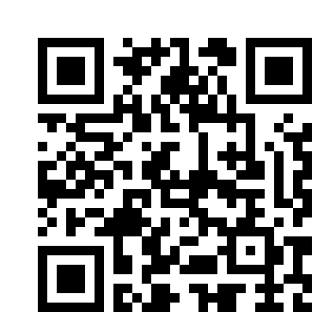
Part 6: Evaluation
Please take a few minutes to complete the evaluation:
https://www.surveymonkey.com/r/PD3evaluation
Notes:
Part 6 (suggested time 5 minutes) is for an online session evaluation.
Provides a link to a session evaluation.
Please check that you have the group number which allows the responses of this set of participants to be identified.
https://www.surveymonkey.com/r/PD3evaluation
The link can be sent to teachers by email so that they can click on it for their responses.

Slide 38
Strategy 1: Providing experiences that give all students access to the subsequent tasks
How does this “experience” increase the chances of all students engaging with the subsequent task?
Notes:
Strategy 1 emphasises building learning on a common experience.
The next slides illustrate how the introductory experience informs the subsequent inquiry task.

Slide 39
The experience of Handfuls …
Present students with materials and have them take a handful.
Ask students to estimate how many items they have in their handful.
Notes:
A task from the Foundation sequence on Structure of Number.
Invite participants to do this and imagine what Foundation level students might do.

Slide 40
… and the subsequent Handfuls task …
Carefully count your collection.
Organise your collection in a way that someone else could quickly see how many items there are in your collection.
Explain why your collection might be easy to count.
Notes:
…followed by the task.
Have the teachers work through the task.
Invite participants to discuss in what ways the experience (of estimating the handfuls) informed the subsequent task (of presenting the collection in an organised way).

Slide 41
Strategy 2: Posing tasks with “low floors” and “high ceilings” so that all students are working on the same task even if in different ways.
Notes:
Strategy 2 is that posing tasks with low floors and high ceilings can offer appropriate challenge to all students.
The next slide gives examples of students’ responses to illustrate both perspectives.

Slide 42
In the Handfuls task
A low floor response might be when students …
Count their collection correctly even if not arranged in an organised way
A high ceiling response might be when students …
Arrange their counters in groups such as 5s or 10s
Notes:
The point being that with all students working on the same task, we might be satisfied if some students respond to the low floor of the task (as described on the slide) while others respond to the high ceiling aspect of the task.

Slide 43
Strategy 3: Preparing additional prompts that can
a. support students experiencing difficulty
b. extend those who are ready
Notes:
Strategy 3 explores the nature and potential of enabling prompts to support students experiencing difficulty and extending prompts for those who are ready.

Slide 44
Supporting students experiencing difficulty – the power of “enabling prompts”
“Telling” students experiencing difficulty what to do runs the risk of entrenching their sense of helplessness.
After completing the prompt, the intention is for students to proceed with the original task.
As a result, those students can feel part of the class community …
… as well as learning self-help strategies.
Notes:
Introduce the idea of enabling prompts. Note that the enabling prompt is a variation on the original task – not a different task altogether. The intention is that after doing the prompt, the students can proceed with the original task and participate in the review of the task with the rest of the class.

Slide 45
An enabling prompt involves reducing the complexity of the original task by changing …
The nature of the representation
The number of steps
The size of the numbers
Notes:
These three strategies can work. They apply not only to the design of prompts but also to interactions with students during the class.

Slide 46
Handfuls - enabling prompts
Changing the size of the numbers – Suggest that students take smaller handfuls.
Changing the nature of the representation – Provide resources such as ten frames and sorting rings/plates to help organise their collection.
Notes:
These are examples of enabling prompts for the Handfuls task. Note how they are different versions of the original Handfuls task.

Slide 47
Extending students who are ready
– the use of “extending prompts”
Extending prompts explore the potential more deeply
Extending prompts:
  Increase complexity and size of numbers
  Find multiple solutions
  Identify all possibilities
  Make a generalisation or rule
Extending prompts do not change contexts – the prompt still meets the purpose of the lesson
Notes:
Introduce the idea of extending prompts. Note that extending prompts are different from the task that everyone else will do later or tomorrow but are intended to deepen the experience of those students who are ready.

Slide 48
Handfuls – extending prompts
Increase complexity and size of numbers: Suggest that students take two handfuls and explore the best way to group the counters to make counting fast.
Back to the task selection slide
Jump to Part 4
Notes:
Because this involves two handfuls (which might or might not be the same size) it makes the organisation of the group more complex and prompts students to develop a rule about organisation.
Click on the navigation rectangle relevant to your plan for the module.

Slide 49
Strategy 1: Providing experiences that give all students access to the subsequent tasks
How does this “experience” increase the chances of all students engaging with the subsequent task?
Notes:
Strategy 1 emphasises building learning on a common experience.
The next slides illustrate how the introductory experience informs the subsequent inquiry task.

Slide 50
The Building Symmetry experience …
Briefly show this structure and have students recreate it from memory.
Notes:
A task from the Year 3 sequence on Spatial Reasoning.
It uses linking cubes. You need enough for 7 cubes for each participant.
Pose the experience to participants as presented on the slide.

Slide 51
…and the subsequent Building Symmetry task…
How many symmetrical shapes can you make by moving one block?
How many symmetrical shapes can you make by adding one block?
Notes:
…followed by the task.
Have the teachers work through both questions and discuss their answers. You might need to spend time before the session familiarising yourself on the range of possible solutions.
Invite participants to discuss in what ways the experience (creating the structure from memory) informs the subsequent task (creating symmetrical structures).

Slide 52
Strategy 2: Posing tasks with “low floors” and “high ceilings” so that all students are working on the same task even if in different ways.
Notes:
Strategy 2 is that posing tasks with low floors and high ceilings can offer appropriate challenge to all students.
The next slide gives examples of students’ responses to illustrate both perspectives.

Slide 53
In the Building Symmetry task
A low floor response might be when students …
Give at least one correct design
A high ceiling response might be when students …
systematically consider a range of possibilities for symmetry
Notes:
We might be satisfied that some students build various structures. Others might be ready for more systematic responses.

Slide 54
Strategy 3: Preparing additional prompts that can
a. support students experiencing difficulty.
b. extend those who are ready.
Notes:
Strategy 3 explores the nature and potential of enabling prompts to support students experiencing difficulty and extending prompts for those who are ready.

Slide 55
Supporting students experiencing difficulty – the power of “enabling prompts”
“Telling” students experiencing difficulty what to do runs the risk of entrenching their sense of helplessness.
After completing the prompt, the intention is for students to proceed with the original task.
As a result, those students can feel part of the class community …
… as well as learning self-help strategies.
Notes:
Introduce the idea of enabling prompts. Note that the enabling prompt is a variation on the original task – not a different task altogether. The intention is that after doing the prompt, the students can proceed with the original task and participate in the review of the task with the rest of the class.

Slide 56
An enabling prompt involves reducing the complexity of the original task by changing …
The nature of the representation
The number of steps
The size of the numbers
Notes:
These three strategies can work. They apply not only to the design of prompts but also to interactions with students during the class.

Slide 57
Building symmetry - enabling prompts
Reducing number of steps – “Remove one block to make your model symmetrical”.
“Look at the new symmetrical model you have made. Can you add a block to your model and still keep it symmetrical?”
Notes:
This has the effect of maintaining the structure of the task but reducing the complexity.

Slide 58
Extending students who are ready
– the use of “extending prompts”
Extending prompts explore the potential more deeply
Extending prompts:
  Increase complexity and size of numbers
  Find multiple solutions
  Identify all possibilities
  Make a generalisation or rule
Extending prompts do not change contexts – the prompt still meets the purpose of the lesson
Notes:
Introduce the idea of extending prompts. Note that extending prompts are different from the task that everyone else will do later or tomorrow but are intended to deepen the experience of those students who are ready.

Slide 59
Building symmetry – extending prompts
Increase complexity and size of numbers:
“What symmetrical objects can you make by adding two blocks to the model?”
“… 3 blocks”?
Back to the task selection slide
Jump to Part 4
Back to menu
Continue to next section
Notes:
This extends student thinking from the original task and hopefully they can build on the systematic approach they used previously.

Slide 60
Strategy 1: Providing experiences that give all students access to the subsequent tasks
How does this “experience” increase the chances of all students engaging with the subsequent task?
Notes:
Strategy 1 emphasises building learning on a common experience.
The next slides illustrate how the introductory experience informs the subsequent inquiry task.

Slide 61
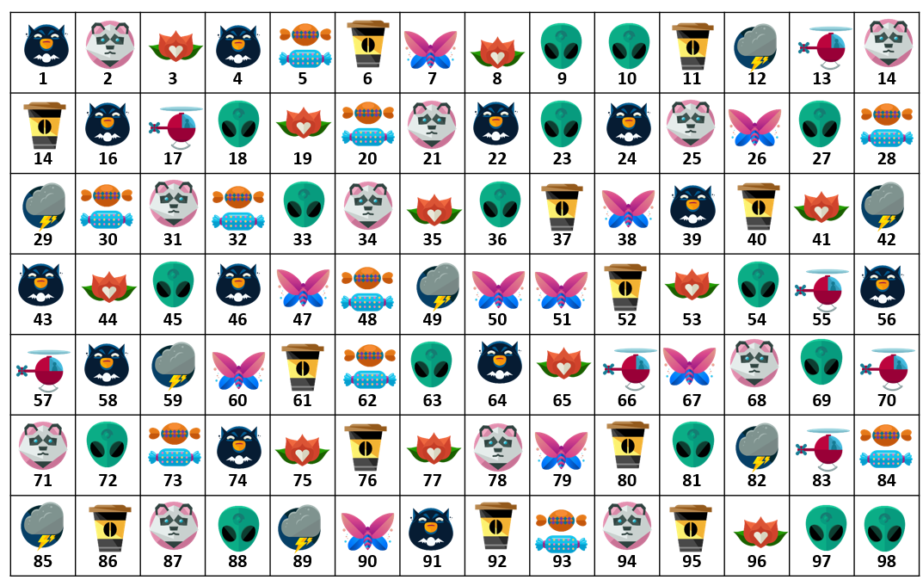
The Mathematical Mind Reading experience …
Write down a 2-digit number whose digits are different
Reverse the digits
Subtract the smaller number from the larger number
Look for the icon that is next to your answer
Notes:
A task from the Year 9 sequence on Algebraic Reasoning.
Invite participants to do the “experience” as though they were Year 9 students.
Note that the full classroom resource can be accessed at Mathematical Mind Reader – Download the slideshow under ‘Related Documents’ http://www.resolve.edu.au/year-9-tens-and-units-1?resource=367 (click on the Link to Mathematical Mind Reader).
Ideally use the slideshow with the classroom resources that make this experience dynamic.

Slide 62
…and the subsequent Mathematical Mind Reading task…
How does this work?
What pattern do the solutions follow?
How can we represent this process algebraically?
Notes:
…followed by the task.
Have the teachers work through the task.
Invite participants to discuss in what ways the experience (selecting a two digit number etc..) informs the subsequent task (explaining how the “mind reading” works).

Slide 63
Strategy 2: Posing tasks with “low floors” and “high ceilings” so that all students are working on the same task even if in different ways.
Notes:
Strategy 2 is that posing tasks with low floors and high ceilings can offer appropriate challenge to all students.
The next slide gives examples of students’ responses to illustrate both perspectives.

Slide 64
Mathematical Mind Reading
A low floor response might be when students …
perform more than one calculation correctly and match the answer to the symbol
A high ceiling response might be when students …
explain how the mind reading trick works using algebraic representation
Notes:
We might be satisfied that some students can do some calculations correctly along with matching the answer to the symbol and so see that something surprising is happening. Others might be ready for a generalised description of how the mind reading trick works.

Slide 65
Strategy 3: Preparing additional prompts that can
a. support students experiencing difficulty
b. extend those who are ready
Notes:
Strategy 3 explores the nature and potential of enabling prompts to support students experiencing difficulty and extending prompts for those who are ready.

Slide 66
Supporting students experiencing difficulty – the power of “enabling prompts”
“Telling” students experiencing difficulty what to do runs the risk of entrenching their sense of helplessness.
After completing the prompt, the intention is for students to proceed with the original task.
As a result, those students can feel part of the class community …
… as well as learning self-help strategies.
Notes:
Introduce the idea of enabling prompts. Note that the enabling prompt is a variation on the original task – not a different task altogether. The intention is that after doing the prompt, the students can proceed with the original task and participate in the review of the task with the rest of the class.

Slide 67
An enabling prompt involves reducing the complexity of the original task by changing …
The nature of the representation
The number of steps
The size of the numbers
Notes:
These three strategies can work. They apply not only to the design of prompts but also to interactions with students during the class.

Slide 68
Mathematical Mind Reading
– enabling prompts
Changing the nature of the representation – “Look at the animated graphic to visualise how 2-digit numbers can be represented algebraically”
Notes:
The classroom resource includes a slideshow in which uses counters to illustrate the process of writing any two digit number in the form 10a + b. This change to make the representation more explicit can make the algebraic form clearer.
The animated graphic is available at http://www.resolve.edu.au/year-9-tens-and-units-1?resource=367. Show the animated graphic and invite participants to comment on how this changes the nature of the representation.

Slide 69
Extending students who are ready
– the use of “extending prompts”
Extending prompts explore the potential more deeply
Extending prompts:
  Increase complexity and size of numbers
  Find multiple solutions
  Identify all possibilities
  Make a generalisation or rule
Extending prompts do not change contexts – the prompt still meets the purpose of the lesson
Notes:
Introduce the idea of extending prompts. Note that extending prompts are different from the task that everyone else will do later or tomorrow but are intended to deepen the experience of those students who are ready.

Slide 70
Mathematical Mind Reading
– extending prompts
Increase complexity and size of numbers: “Can you use algebra to predict what will happen if we do the same process with a 3-digit number?” “ … more than 3 digits?”
Back to the task selection slide
Jump to Part 4
Back to menu
Continue to next section
Notes:
This extends the thinking of students who are ready in significant ways.
You might invite participants to do this.

Slide 71
Strategy 1: Providing experiences that give all students access to the subsequent tasks
How does this “experience” increase the chances of all students engaging with the subsequent task?
Notes:
Strategy 1 emphasises building learning on a common experience.
The next slides illustrate how the introductory experience informs the subsequent inquiry task.

Slide 72
The Chinese Bamboo experience …
Take a piece of “bamboo”. Bend it so that the top touches the ground. Calculate the horizontal distance between the top and bottom of the bamboo and the height of the bend.
Notes:
A task from the Year 10 sequence on Pythagoras.
Invite participants to do the “experience” as though they were Year 10 students. The resource suggests using 40 cm lengths of florist wire (pipe cleaners can work) as a substitute for bamboo. If you are presenting this example, it is worth reading the documentation of the classroom resources which is available at Chinese Bamboo - http://www.resolve.edu.au/year-910-pythagoras-and-trigonometry-trial. (you may need to log in)

Slide 73
…and the subsequent Chinese Bamboo task…
Given the total height of the bamboo and the horizontal distance from the base of the bamboo and the top, calculate the height to the break.
Compare to the solution given on a traditional Chinese manuscript.
Notes:
…followed by this task.
Have the teachers work through the task.
Invite participants to discuss in what ways the experience (bending the bamboo) informs the subsequent task (formalising the relationship and the calculations)
The solution in the manuscript is given as follows. Participants can discuss:
Take the square of the distance from the foot of the bamboo to the point at which its top touches the ground, and divide this by the length of the bamboo. Subtract the result from the length of the bamboo, and halve the resulting difference. This gives the height of the break.

Slide 74
Strategy 2: Posing tasks with “low floors” and “high ceilings” so that all students are working on the same task even if in different ways.
Notes:
Strategy 2 is that posing tasks with low floors and high ceilings can offer appropriate challenge to all students.
The next slide gives examples of students’ responses to illustrate both perspectives.

Slide 75
In the Chinese Bamboo task
A low floor response might be when students …
find one set of values for the measurements.
A high ceiling response might be when students …
describe a pattern in responses for different locations of the bend.
Notes:
We might be satisfied that some students find one set of measurements. Others might extend their thinking by finding a pattern in the calculations for different locations of the bend.

Slide 76
Strategy 3: Preparing additional prompts that can
a. support students experiencing difficulty
b. extend those who are ready
Notes:
Strategy 3 explores the nature and potential of enabling prompts to support students experiencing difficulty and extending prompts for those who are ready.

Slide 77
Supporting students experiencing difficulty – the power of “enabling prompts”
“Telling” students experiencing difficulty what to do runs the risk of entrenching their sense of helplessness.
After completing the prompt, the intention is for students to proceed with the original task.
As a result, those students can feel part of the class community …
… as well as learning self-help strategies.
Notes:
Introduce the idea of enabling prompts. Note that the enabling prompt is a variation on the original task – not a different task altogether. The intention is that after doing the prompt, the students can proceed with the original task and participate in the review of the task with the rest of the class.

Slide 78
An enabling prompt involves reducing the complexity of the original task by changing …
The nature of the representation
The number of steps
The size of the numbers
Notes:
These three strategies can work. They apply not only to the design of prompts but also to interactions with students during the class.

Slide 79
Chinese Bamboo – enabling prompts
Changing the nature of the representation – Suggest some possible numerical values for the bamboo lengths with which the students can experiment.
Notes:
This prompt has the advantage of reducing the number of variables, and therefore the steps in the task.

Slide 80
Extending students who are ready
– the use of “extending prompts”
Extending prompts explore the potential more deeply
Extending prompts:
  Increase complexity and size of numbers
  Find multiple solutions
  Identify all possibilities
  Make a generalisation or rule
Extending prompts do not change contexts – the prompt still meets the purpose of the lesson
Notes:
Introduce the idea of extending prompts. Note that extending prompts are different from the task that everyone else will do later or tomorrow but are intended to deepen the experience of those students who are ready.

Slide 81
Chinese Bamboo – extending prompts
Make a generalisation or rule
Show the equivalence between the rule for the Bamboo and the Chinese statement.
Back to the task selection slide
Jump to Part 4
Back to menu
Continue to next section
Notes:
This extends the thinking of students who are ready in significant ways.

Slide 82
Shadows
What objects might have made these shadows?
Back to the task selection slide
Jump to Part 5
Notes:
This is a Year 1 task in the Spatial Reasoning sequence.
Invite participants to discuss in small groups how the task might be differentiated (through an initial experience, what the floor and ceiling might look like, and enabling and extending prompts).

Slide 83

In this bag, I have red counters and blue counters.
I take out 4 counters.
What are my possible scores?
Tossing Counters
= 2 points
= 5 points
Back to the task selection slide
Jump to Part 5
Notes:
This is part of a Year 3 sequence.

Slide 84
Algebra Cloud
Back to the task selection slide
Jump to Part 5
Notes:
This task is part of an algebra sequence introducing “like terms” to Year 7 students.

Slide 85
Jamos the Jeweller
Jamos the Jeweller charges clients based on the amount of precious metal wire used in their jewellery designs.
A customer has provided the following design brief for Jamos to create a new design. Can you help?
  A symmetrical design, with at least three different sized circles and with the metal costing between $600 and $650
Jamos charges clients $25 per linear centimetre of the wire used.
Back to the task selection slide
Jump to Part 5
Notes:
This is a Year 8 task in the Measurement and Geometry sequence.
Invite participants to discuss in small groups how the task might be differentiated (through an initial experience, what the floor and ceiling might look like, and enabling and extending prompts)

